Slide 1
Note that “support” and “quasar” might be two different support lists?
I get this…not resolved as of 5-22-2020?
Look into it a little more…

Slide 2
Note that “support” and “quasar” might be two different support lists?

Slide 3
Here is the current skyline code for installing the packages: what if you change “http:” to “https”?
#Install QuaSAR Packages
a<-installed.packages()
packages<-a[,1]
if (!is.element("bitops",packages)){
install.packages("bitops" , repos='http://cran.us.r-project.org')
}
if (!is.element("reshape",packages)){
install.packages("reshape" , repos='http://cran.us.r-project.org')
}
if (!is.element("gtools",packages)){
install.packages("gtools" , repos='http://cran.us.r-project.org')
}
if (!is.element("boot",packages)){
install.packages("boot" , repos='http://cran.us.r-project.org')
}
if (!is.element("ggplot2",packages)){
install.packages("ggplot2" , repos='http://cran.us.r-project.org')
}
if (!is.element("gplots",packages)){
install.packages("gplots" , repos='http://cran.us.r-project.org')
}

Slide 4
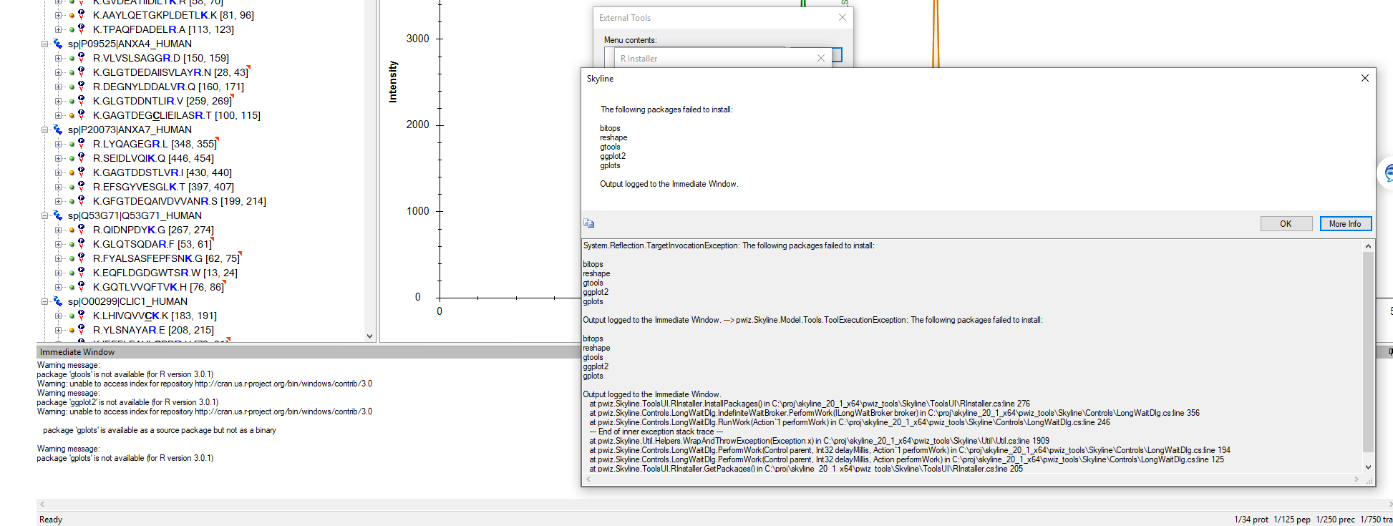
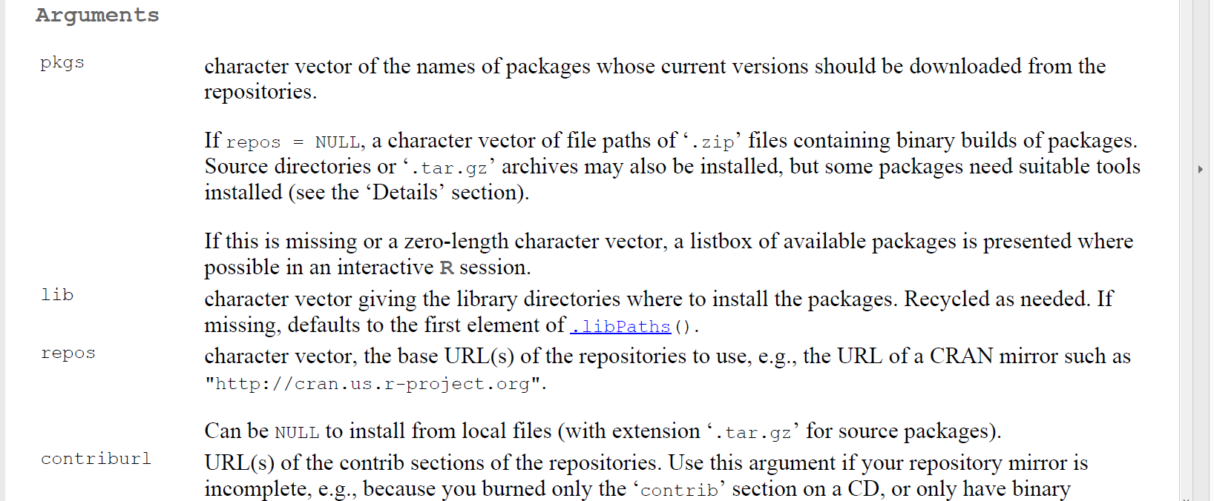
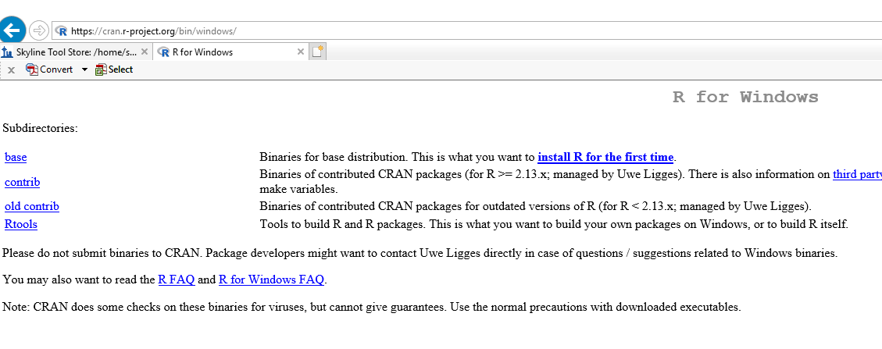
Is a missing “S” (http: instead of https) causing this problem? Probably not, see above…but also see next…

Slide 5
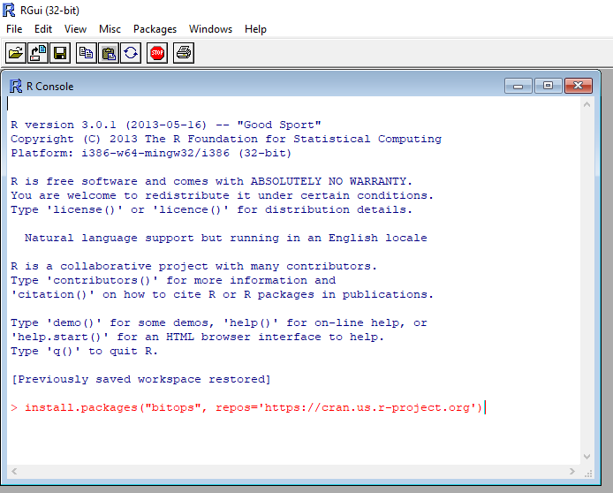
5-27-2020 tried this
But this was with R 3.0.1, note the added “S” to “http:”

Slide 6
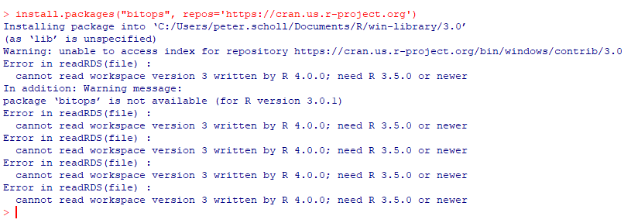
5-27-2020 got this result /failure from adding “https”
But this was with R 3.0.1
So I tried again using R 3.6.2

Slide 7
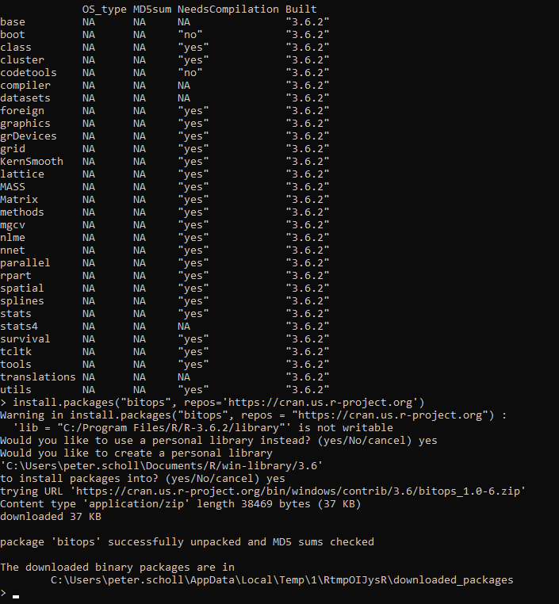
Tried again but this time using R 3.6.2
Interestingly, now, as a test, bitops unpacks as a binary
See next page, but looks like “bitops” installed because installed.packages() show it in next page

Slide 8
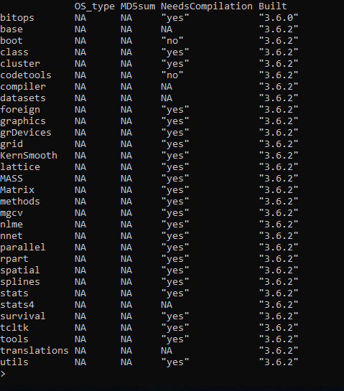
Tried again but this time using R 3.6.2
looks like “bitops” installed because installed.packages() show it in next page
Maybe you just need both new and old R to make this work? I don’t know.

Slide 9
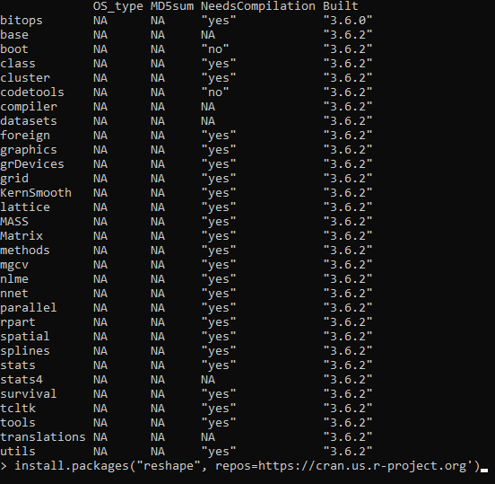
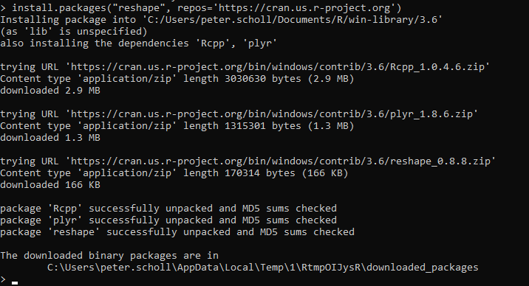
Try here to install reshape using r 3.6.2
You missed a ‘ below just before https
See next page to verify installation of reshape and dependencies

Slide 10
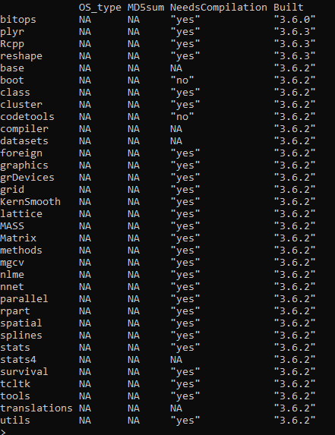
See package reshap is now installed, along with dependencies
Rccp and plyr
Do the same thing with packages required for QuaSAR

Slide 11
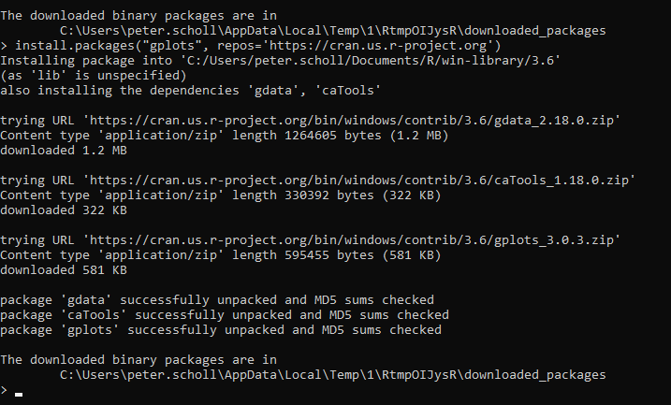

Slide 12
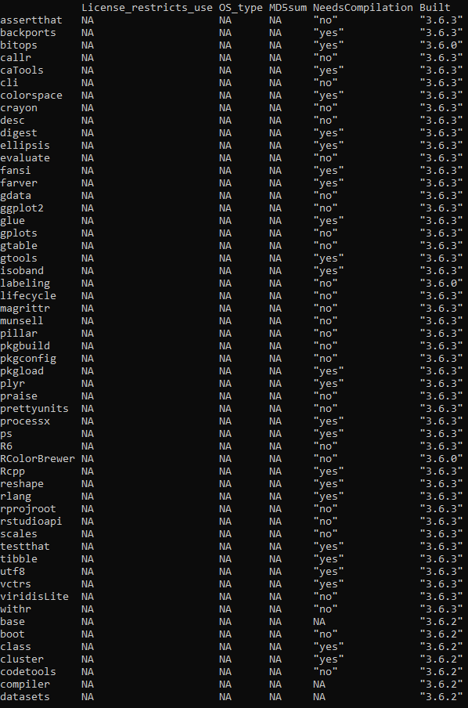
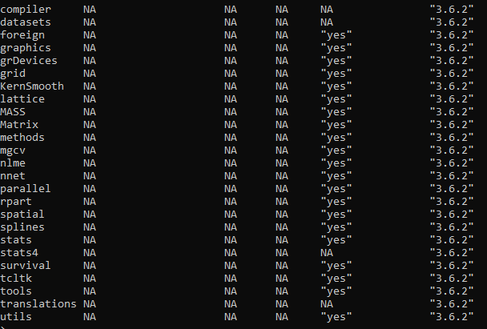
So R 3.6.2 installed required packages and dependencies
But what will happen if I now try to install QuaSAR again? Will it know I’ve already got the packages, or will it try to install over, or throw another error message? I wish I knew more R!

Slide 13
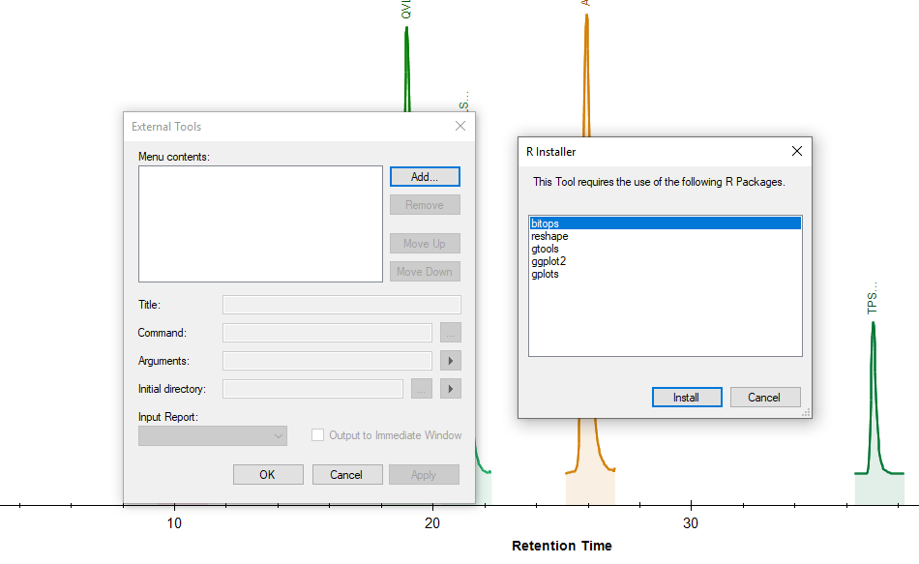
5-27-2020 try again to install QuaSAR as external tool….since packages already installed, hope this just recognizes it, if lib path is read? So as to progress to QuaSAR installation scripts for Skyline?

Slide 14
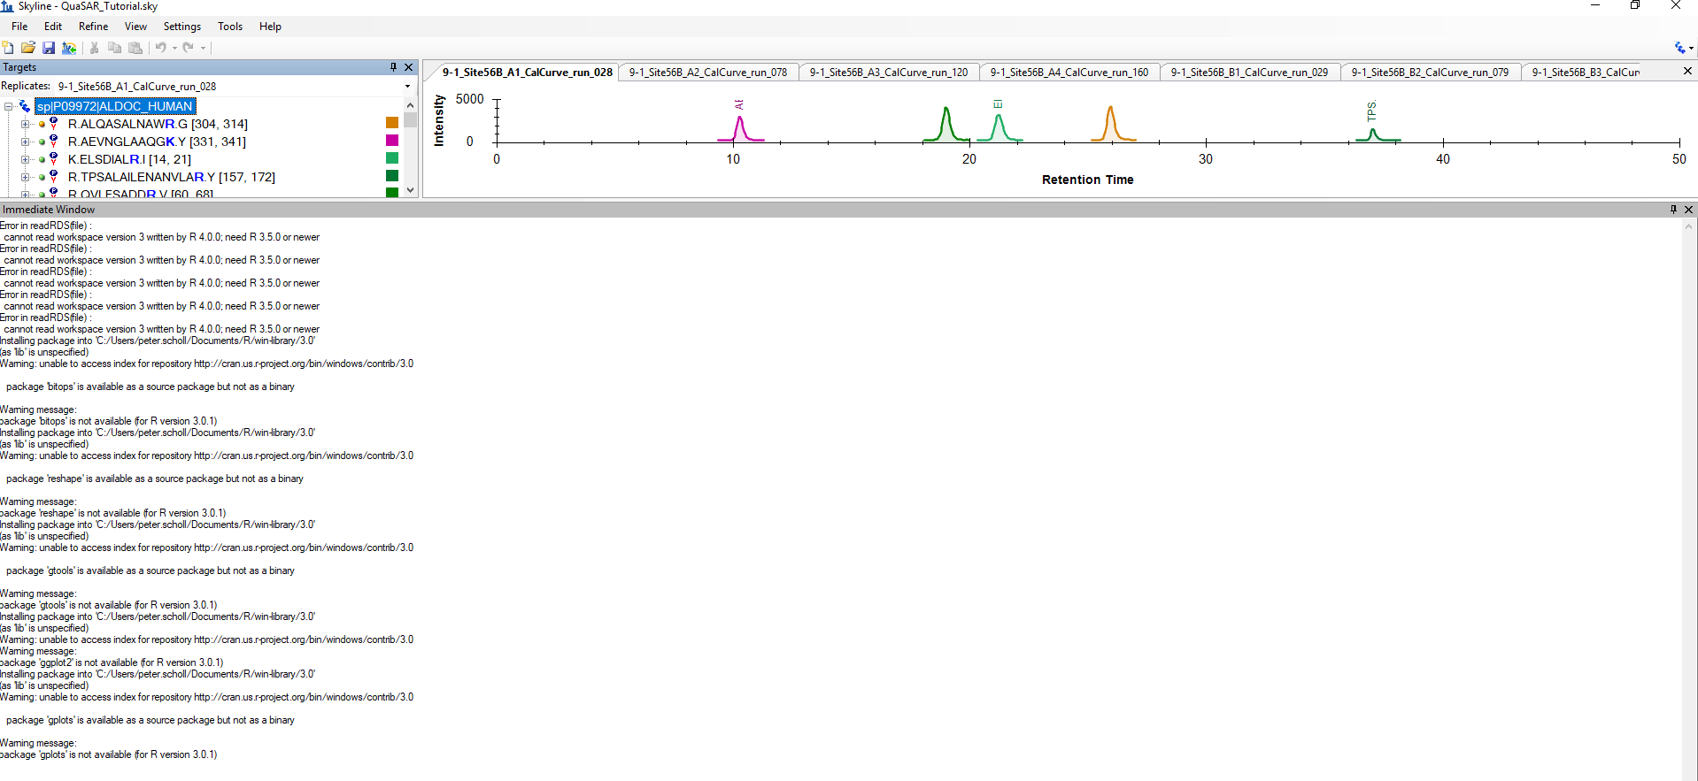
5-27-2020 failed again….unfortunately, my ignorance of R forces me to leave it here.

Slide 15
Miscellaneous notes follow this slide.

Slide 16
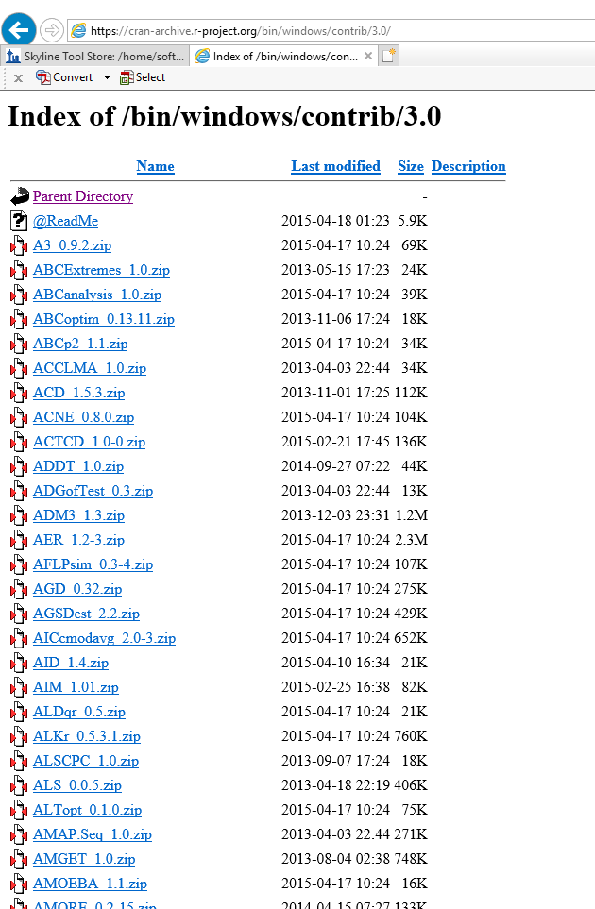
Manually Copy and install : bitops, reshape, gtools, ggplot2, gplots from this site?

Slide 17
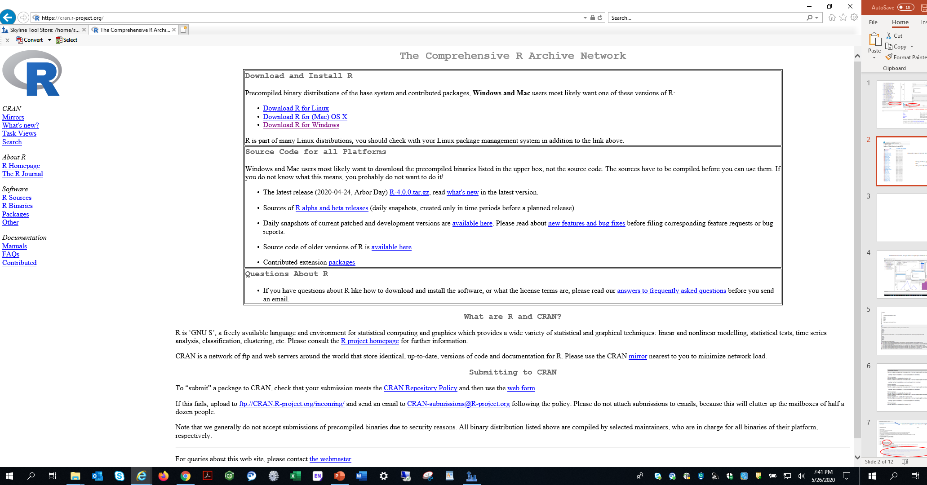
In this slide deck I used R 3.0.1 (failure) and R 3.6.2 (packages did install) via install.packages(“bitops”, repo=‘https://cran.us.r-project.org’)

Slide 18
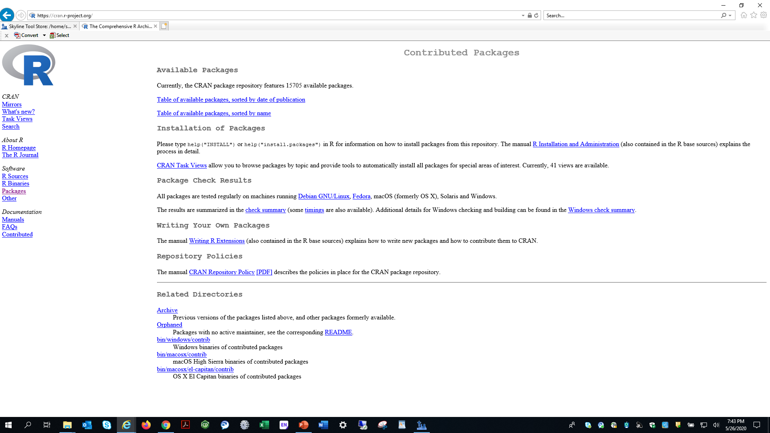

Slide 19
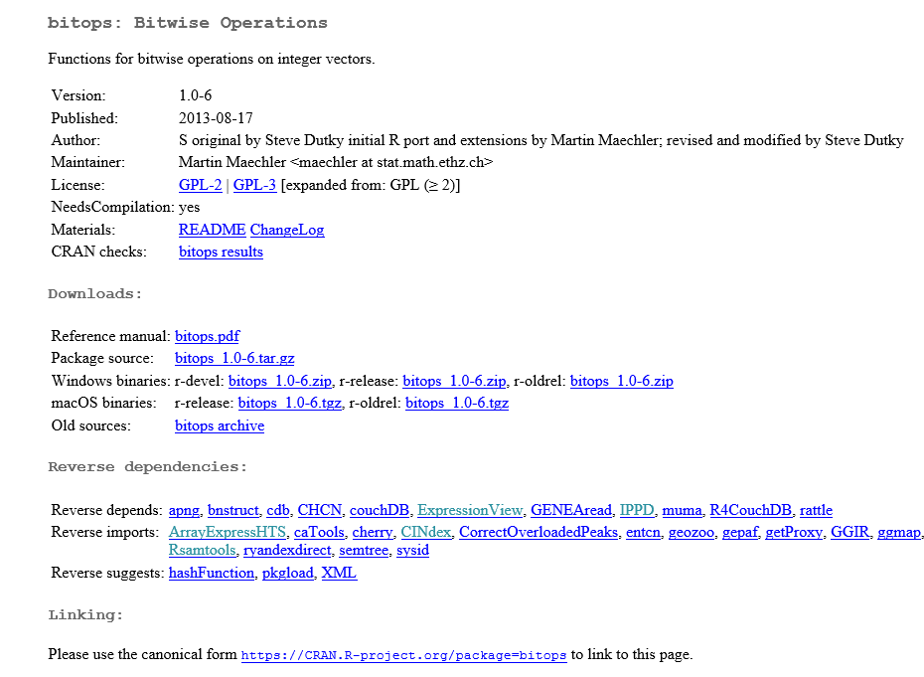
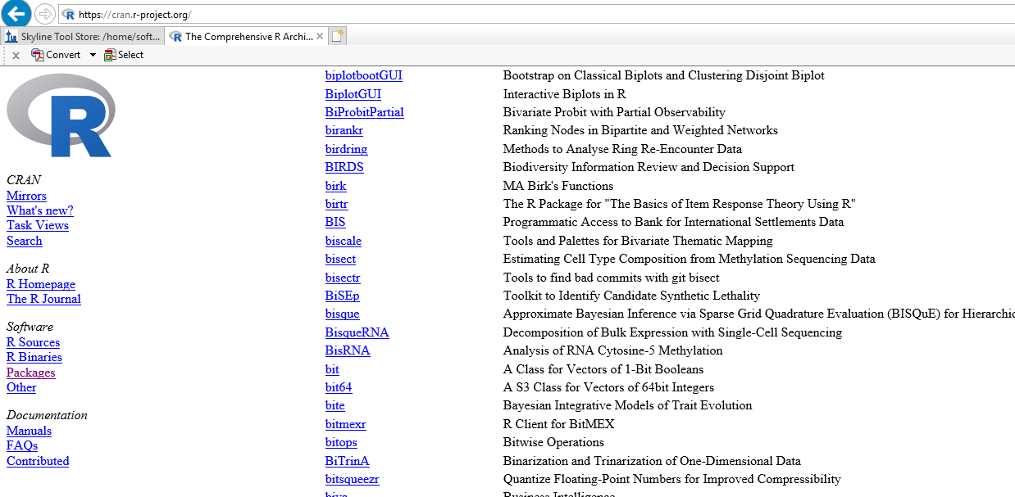

Slide 20
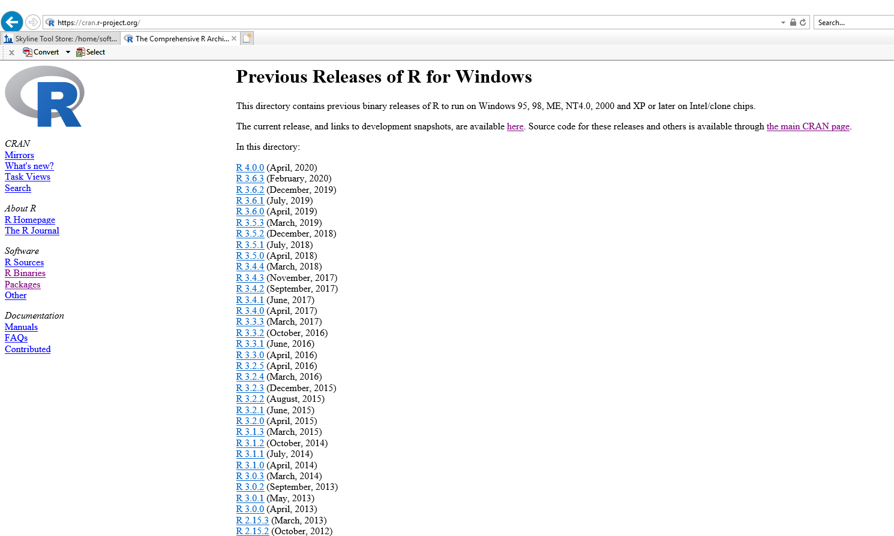
If you already had r 3.0.1 installed as binary, would Skyline try to write over it for the installation indicated in the tutorial?

Slide 23
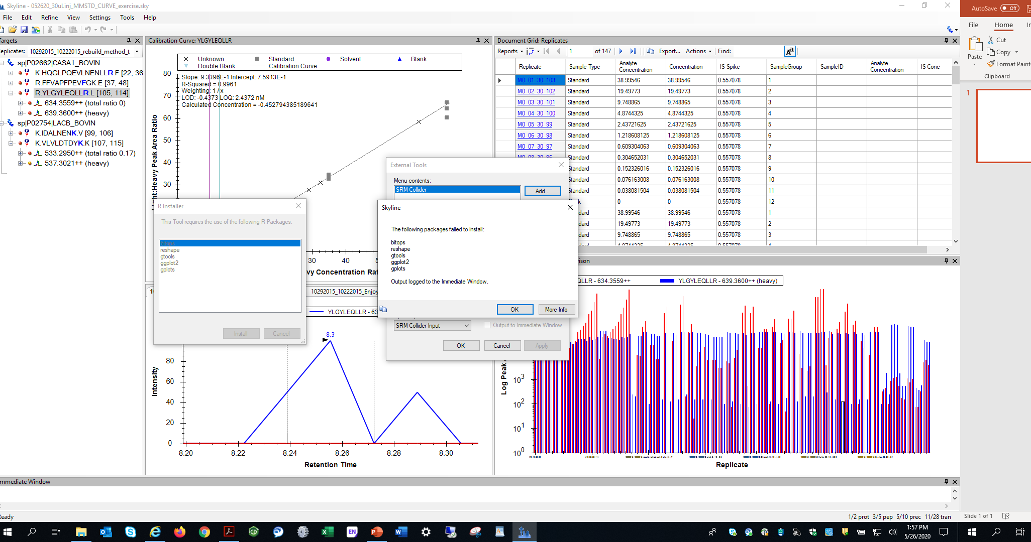
Followed tutorial installation instruction (QuaSAR-1_32), but got this message upon attempt to install QuaSAR via external tools

Slide 24
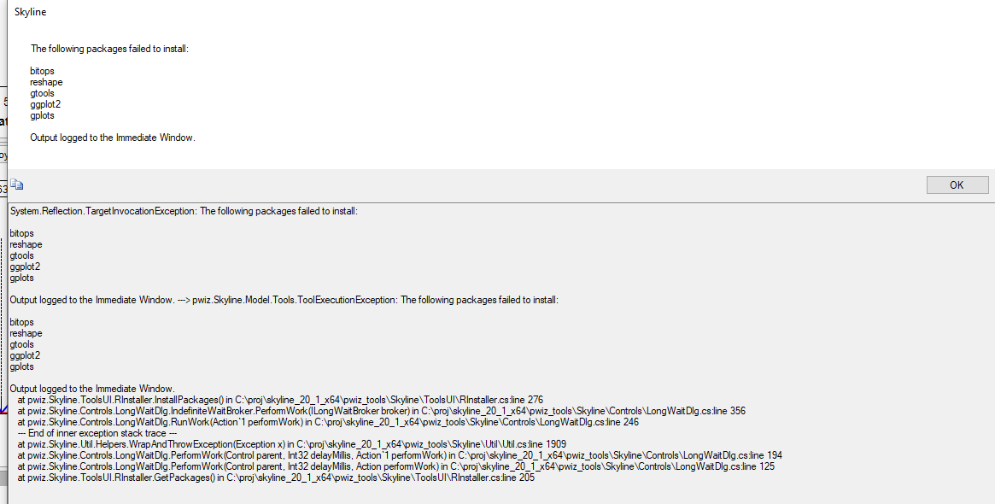
There is more, see next page

Slide 25
