Slide 1
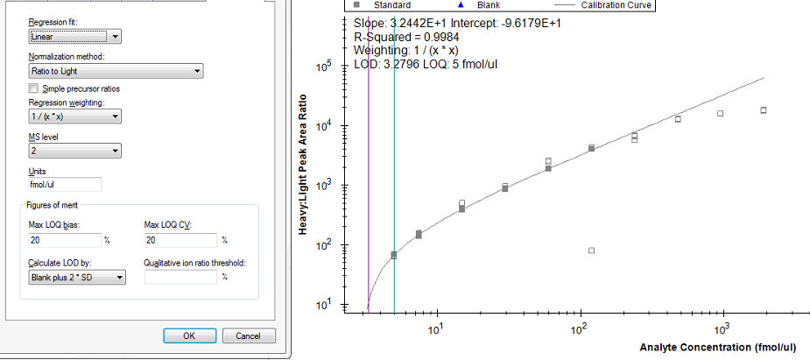
Regression weighing: 1/x*x
Linear

Slide 2
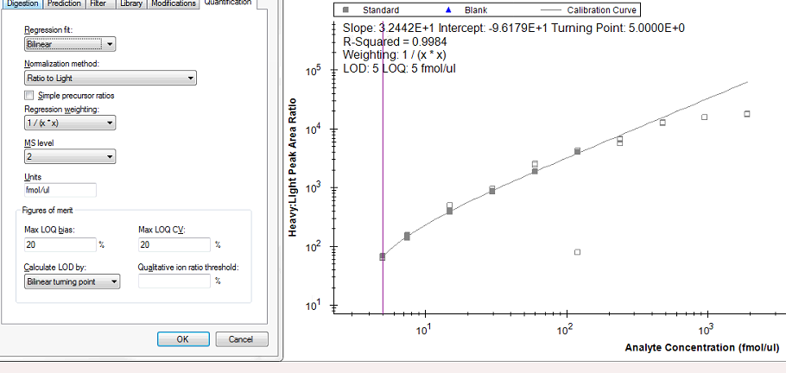
Regression weighing: 1/x*x
Bilinear

Slide 3
Old slides

Slide 4
Regression weighing: None
Linear through Zero
Linear

Slide 5
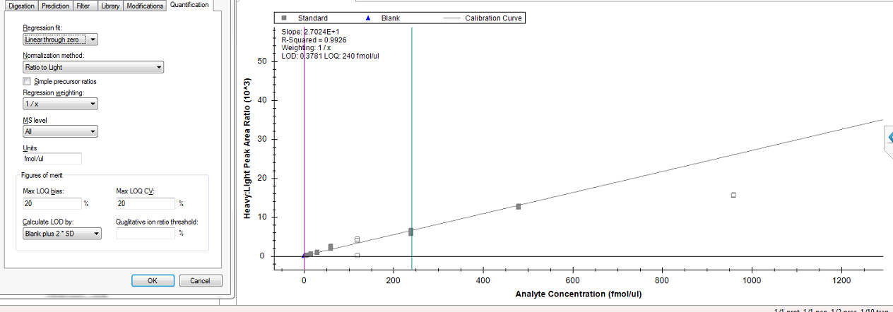
Regression weighing: 1/x
Linear through Zero
Linear

Slide 6
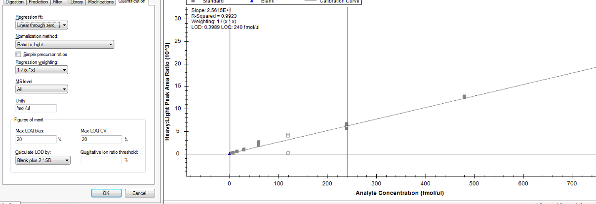
Regression weighing: 1/x*x
Linear through Zero
Linear

