Slide 1
Preparation
View → text zoom → large
Set properties text size to 14 point

Slide 2
CONTEXT
We are going to use Skyline to generate the isolation list to be used for our DIA method

Slide 3
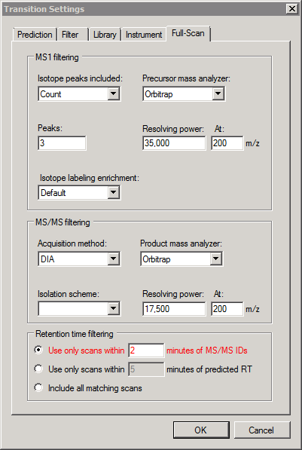
Transition Settings – Full Scan
Click this last

Slide 4
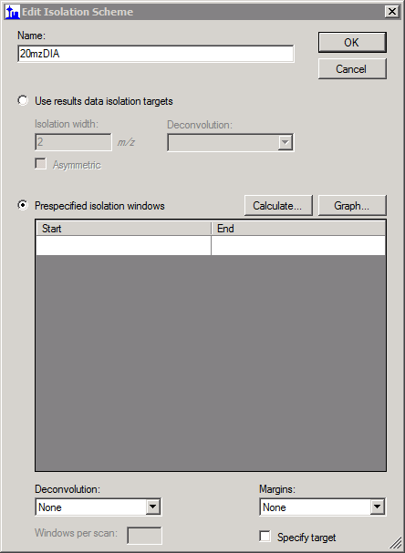
Edit isolation scheme

Slide 5
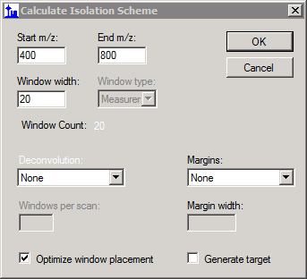
Calculate isolation scheme
400 – 800 because the sample data covers this, normally do 500 - 900

Slide 6
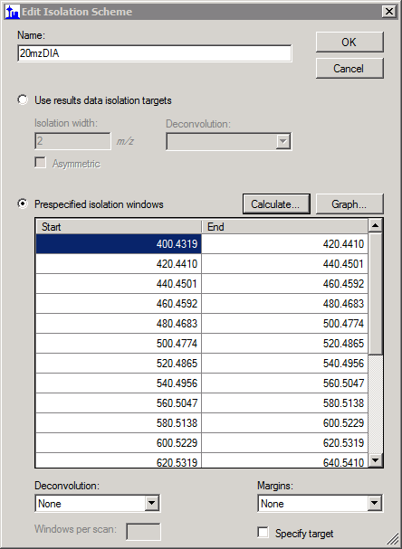
Graph isolation scheme

Slide 7
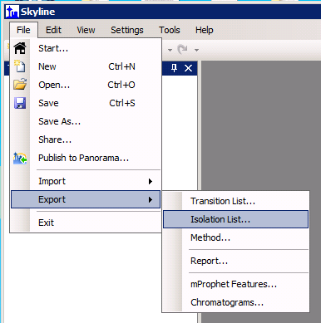
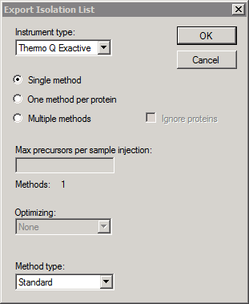
Export Isolation List
methods / DIAIsolationList.csv

Slide 8
Save Skyline doc to skydocs / DIA.sky and open QE method editor (Xcalibur → Instrument Setup)

Slide 9
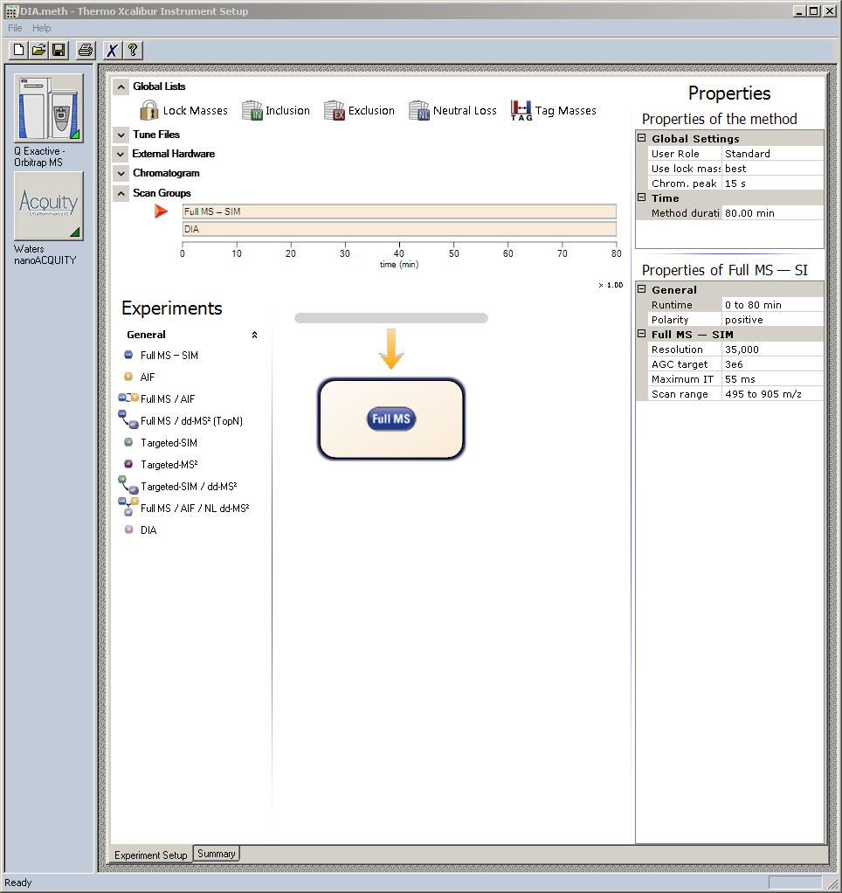
Full MS Settings

Slide 10
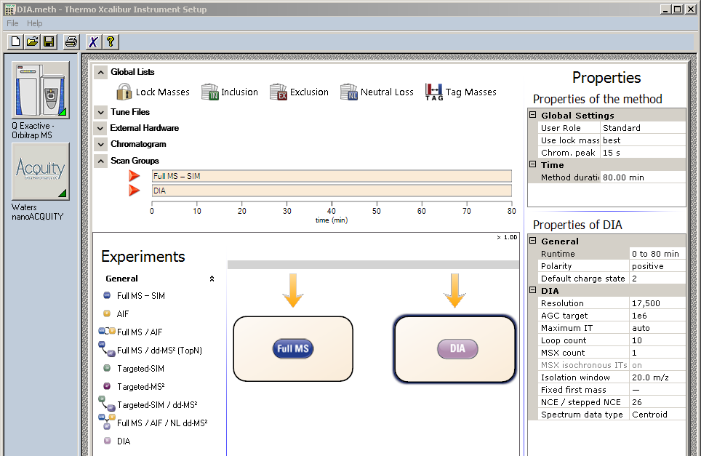
DIA Settings

Slide 11
Import Isolation list

Slide 12
CONTEXT
We are going to start defining our document – the set of peptides, and transitions we would like to extract. Informed by the DDA data.

Slide 13
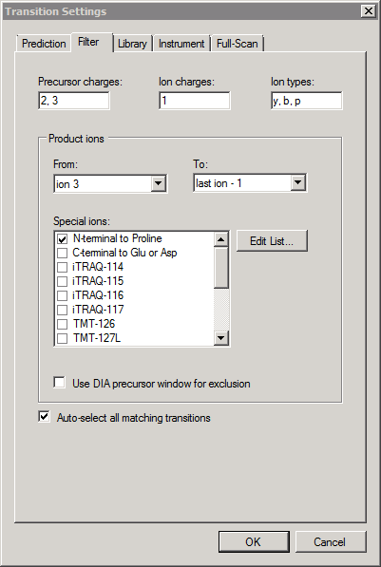
Transition Settings → Filter

Slide 14
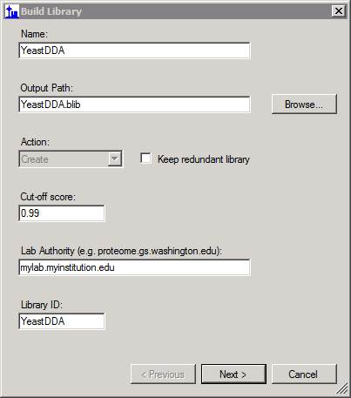
Settings -> Peptide Settings -> Library -> Build…
Point to spectralLibrary/YeastDDA.blib

Slide 15
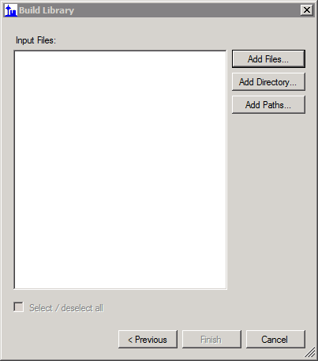
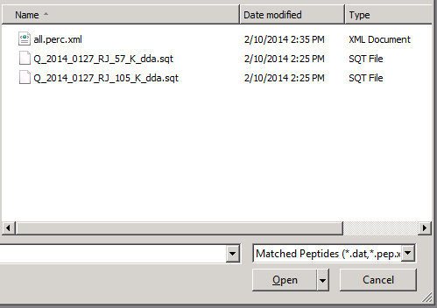
Build library
Click and hit all files to show all of the files in the directory

Slide 16
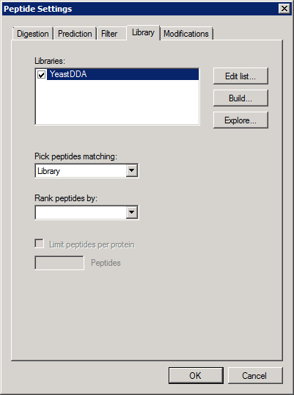
Settings → Peptide Settings → Library
Explain this, and how it means
That skyline will only analyze
Peptides that were identified in
Our DDA library

Slide 17
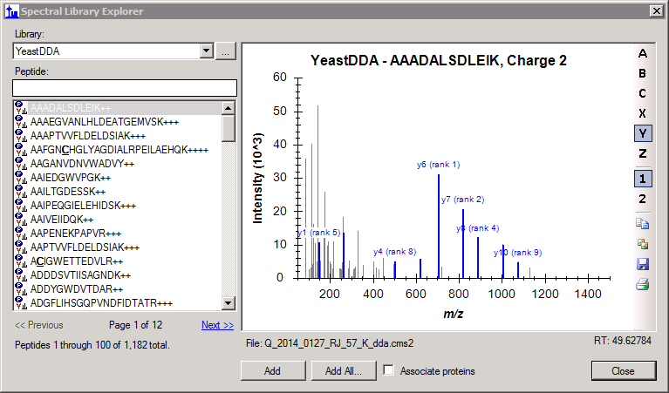
View → Spectral Libraries
Mention we need to have
the background proteome
To associate peptides with
proteins

Slide 18
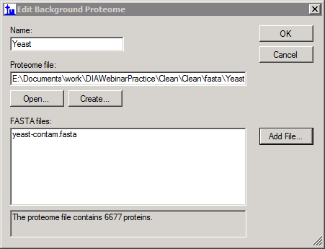
Build a background proteome: Settings → Peptide Settings → Digestion (change max missed cleavages to 2)
Point to fasta folder
Click OK → OK to exit out of peptide settings box

Slide 19
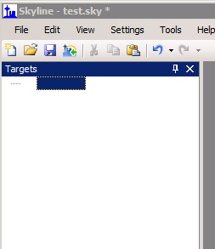
Inserting Proteins in the Main Window
Click here and start typing:
Insert “pyruvate decarboxylase” (YLR044C)
Type “glycolysis” and insert YCR012W
Explain the protein → Peptide → Transition Hierarchy
Show library spectrum

Slide 20
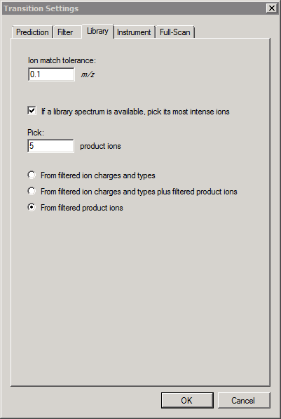
Settings → Transition Settings → Library
Click on Filter tab to remind people
The set of ions we’re filtering
(ion 3 -> last ion -1) … we choose
This to avoid the case where there
Is a strong y1 peak in a library
spectrum

Slide 21
Show the transitions lists with 5 transitions now for a few peptides, then delete all

Slide 22
Inserting Proteins by name Edit → Insert → Proteins
Pyruvate decarboxylase – works (use YLR044C)
Click on some of the peptides to show the spectra
Show precursors and transitions. (If they don’t show up click
View → Library Match)
Try TOR1 and show how it doesn’t insert
Because there aren’t any peptides that were identified in
Our spectral library

Slide 23
CONTEXT
We are now going to insert all of the peptides in the DDA library

Slide 24
View → Spectral Libraries

Slide 25
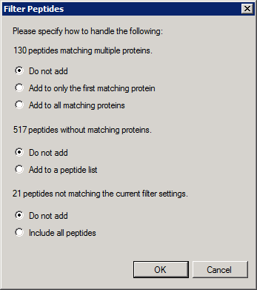
Explain these
After this, delete trypsin contaminant

Slide 26
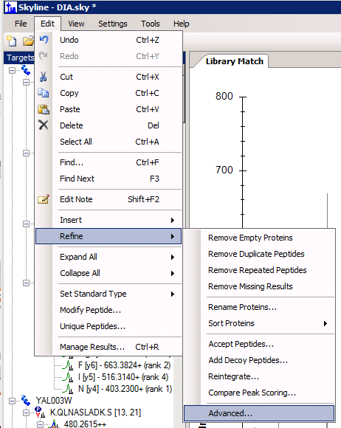
Show how some of the peptides have no product ion transitions, or a low number
Ctrl F for peptide SDVIFPILIPT

Slide 27
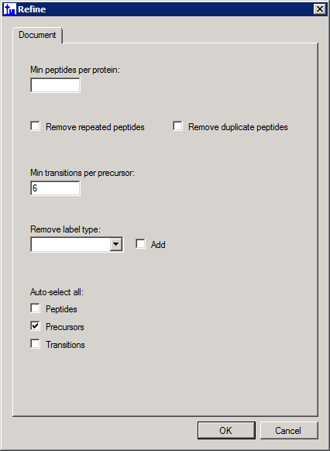
Refine to only keep peptides with 3 or more product transitions
Do ctrl-Z and ctrl-Y to show before and after precursor count

Slide 28
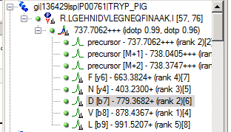
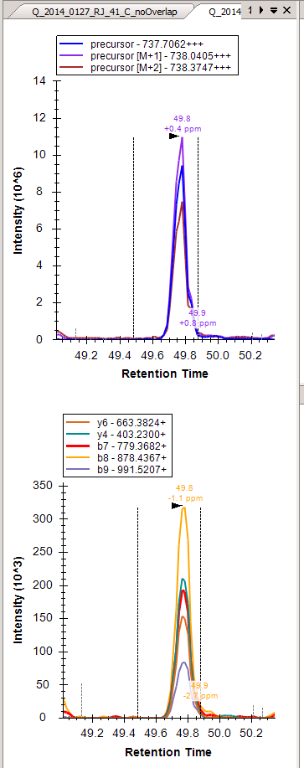
Import Results – 40_D_noOverlap 41_C_noOverlap
Ctrl + F -> YAL038W
Switch peptides, show graphs changing
Split View
Auto Zoom
Integration Boundaries
Show Peptide IDs from Other Run
Click on transitions, show highlighting on graph
Explain ranking on transitions
PPM Error
Show spectrum
Zoom out to see more of spectrum

Slide 29
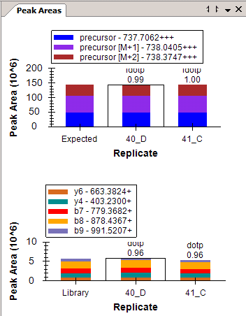
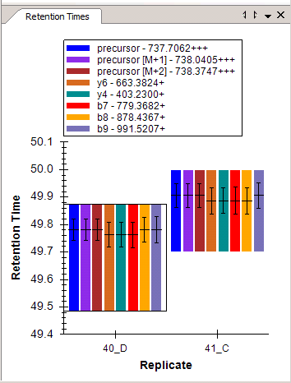
Import Results – Peak Area and Retention Time
Show peak area replicate graph
Live graph – demonstrate by adjusting integration boundaries
Show retention time replicate graph
Explain the meaning of the bars (center and FWHM of peak)
Click on other peptides to show how these graphs update
Move all graphs into document as panes and click View → Arrange Graphs → Tiled

Slide 30
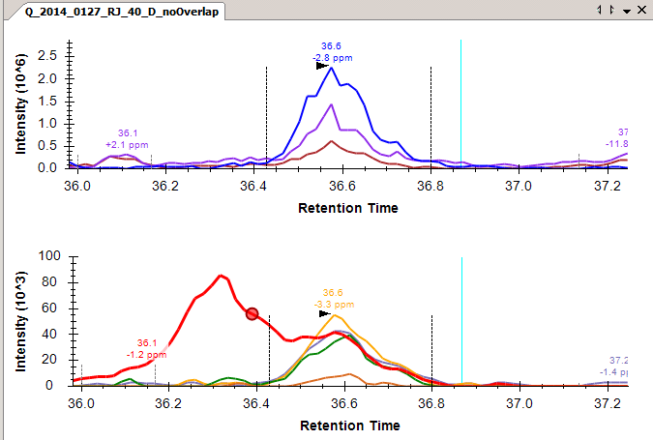
Manual refinement of transitions
Find a transition with interference (YAL038W – SNLAGKPVIC)
Show the spectrum from it
Delete the transition

Slide 31
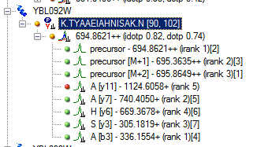
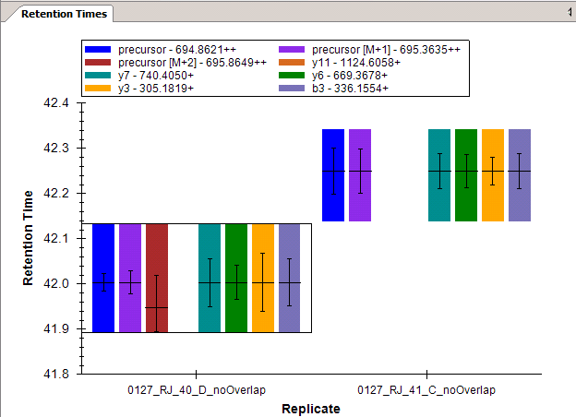
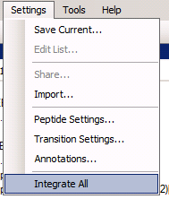
Integrate All Demonstration
Ctrl -> F -- TYAAEIAHNISAK
y11 is a “misbehaving transition”
It doesn’t show up in the retention time graph
And won’t be integrated unless….
Settings –> Integrate All

Slide 32
Results Grid Demonstration
View → Results Grid
Click on a protein, then a peptide, then a precursor, then a transition
Click back on the precursor, change integration boundaries, and show resulting change in area on results grid.
Right click in the results grid and click choose columns
Add “Total Area MS1”
Add “Total Area Fragment”
Remove some of the columns on the right
Click around to show how it stays updated

Slide 33
Report Export
Replicates
Replicate Name
Proteins
Protein Name
Proteins → Peptides
Peptide Modified Sequence
Proteins -> Peptides -> Precursors
Precursor Charge
Proteins -> Peptides -> Precursors -> Precursor Results
Total Area MS1
Total Area Fragment
Hit Preview
Enter View Name – Test Report
Export Test Report to reports directory
Open in Excel

